Slide 1
Strategic Management in the Multinational Company:
Content and Formulation
Multinational Management
耿延

Slide 2
Learning Objectives (1 of 2)
Define generic strategies of differentiation and low cost
Understand how low-cost and differentiation strategists make money.
Recall multinational examples of the use of generic strategies.
Understand competitive advantage and the value chain and how they apply to multinational operations.
Understand how multinational firms use offensive and defensive strategies.

Slide 3
Learning Objectives (2 of 2)
Understand the basics of multinational diversification.
Understand how to apply the traditional strategy formulation techniques, industry and competitive analysis, and company situation analysis to the multinational company.
Realize that the national context affects both convergence and divergence in the strategies used by multinational companies.

Slide 4
Basic Strategic Content
Applied to the
Multinational Company (1 of 2)
Strategy:
  the central, comprehensive, integrated, and externally oriented set of choices structuring how a company exploits its core competencies to achieve its objectives

Slide 5
Basic Strategic Content
Applied to the
Multinational Company (2 of 2)
Ideally, a strategy must address important areas such as:
  which businesses a company wants to be in
  how the company will create presence in a market
  how the company will win customers
Multinational companies use many of the same strategies practiced by domestic companies.

Slide 6
Competitive Advantage and Multinational Applications of Generic Strategies (1 of 2)
Generic Strategies are basic ways for companies to achieve and sustain a competitive advantage
Competitive Advantage:
  when a company’s strategy creates superior value for targeted customers, and is too difficult or costly for competitors to copy
Two primary ways to gain a competitive advantage:
  Differentiation
  Low cost

Slide 7
Competitive Advantage and Multinational Applications of Generic Strategies (2 of 2)
Differentiation Strategy:
  finding ways of providing superior value to customers (i.e., exceptional quality, unique features, rapid innovation)
  Example: BMW’s high-quality, high-performance sports cars
Low-cost Strategy:
  Produce or deliver products or services equal to those of competitors, but at a lower cost
  Example: Korean semiconductor firms’ low-cost and productive labor

Slide 8
How Do Low-Cost and Differentiation Firms
Make Money?
Differentiation:
  Customers often pay a higher price for the extra value of a superior product or service
  Example: Swiss chocolatier Tobler-Jacobs charges more for its specially produced (not mass-produced) chocolate
Low-cost
  Additional profits come from cost savings at every step of the process

Slide 9
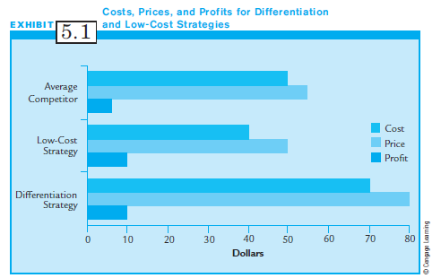
Exhibit 5.1:
Costs, Prices, & Profits for Differentiation & Low-Cost Strategies

Slide 10
Focus Strategy
Strategies can be further subdivided on the basis of competitive scope:
Competitive scope: how broadly a firm targets its products or services
  Narrow competitive scope for limited products or only certain buyers or geographic areas
  Broad competitive scope when many products and a large range of buyers are targeted

Slide 11
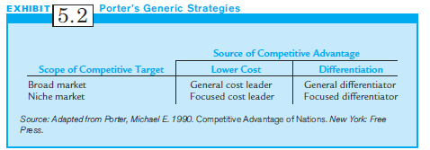
Exhibit 5.2:
Porter’s Generic Strategies

Slide 12
Competitive Advantage and the Value Chain
A firm can gain competitive advantage by finding sources of differentiation or low costs in its activities.
The value chain is a convenient way of looking at the firm’s activities.
Value Chain:
  all the activities that a firm uses to design, produce, market, deliver, and support its product

Slide 13
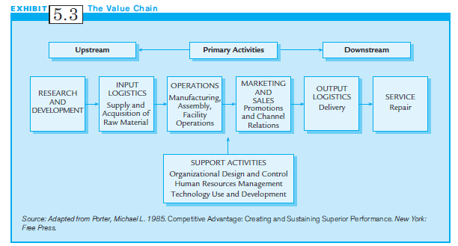
Exhibit 5.3:
The Value Chain

Slide 14
Components of the Value Chain (1 of 2)
Primary activities and support activities:
  Primary Activities: the physical actions of creating, selling, and after-sale service of products
    Upstream: early activities in the value chain, including Research & Development (R&D) and dealing with suppliers
    Downstream: later value chain activities such as sales and dealing with distribution channels

Slide 15
Components of the Value Chain (2 of 2)
Primary activities and support activities (cont’d):
  Support Activities:
    systems for human resources management, organizational design and control, and a firm’s basic technology
Utility of value chain: helps determine internal cost structure by assessing cost levels of different activities
Benchmarked against industry & competitors to know if and where cost advantages or disadvantages exist

Slide 16
Outsourcing (1 of 2)
Outsourcing:
  a deliberate decision to have outsiders or strategic allies perform certain activities in the value chain
Increasingly, MNCs outsource across borders to take advantage of lower costs in other countries.
Outsourcing is a popular and controversial way to correct internal cost disadvantages.

Slide 17
Outsourcing (2 of 2)
When should a multinational company outsource?
  Outsourcing makes sense if an outsider can perform a value-chain task better or more cheaply.
  However, outsourced tasks should not be ones that are crucial to the MNC’s ability to achieve competitive advantage, or the MNC creates competitors.
  The value chain identifies areas in the input, throughput, and output processes where MNCs can find sources of low cost or differentiation advantages.

Slide 18
Distinctive Competencies
Distinctive Competencies:
  Strengths anywhere in the value chain that allow companies to outperform rivals
  Examples: Quality, innovation, customer service
Distinctive Competencies come from two sources:
  Resources
  Capabilities

Slide 19
Resources and Capabilities
Resources:
  inputs into the production or service processes.
  Ex.: Buildings, land, equipment, employees
Resources provide potential capabilities
Capabilities:
  the ability to assemble and coordinate resources effectively
For long-term success, capabilities must lead to a sustainable competitive advantage.

Slide 20
Sustaining
Competitive Advantage
Sustainable Stragtegies:
  strategies not easily neutralized by competitors
Capabilities leading to competitive advantage must be:
    - Valuable
    - Rare
    - Difficult to imitate
    - Non-substitutable

Slide 21
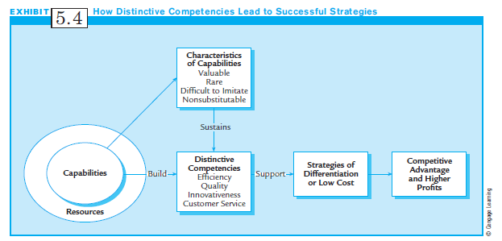
Exhibit 5.4:
How Distinctive Competencies
Lead to Successful Strategies

Slide 22
Competitive Strategies in International Markets
Competitive Strategies are strategic moves multinationals use to defeat competitors.
  - Offensive Competitive Strategies directly attack rivals to capture market share.
  - Defensive Competitive Strategies attempt to beat back or discourage a rival’s offensive strategies.
  - Counter-parries fend off a competitor’s attack in one country while attacking it in another country.

Slide 23
Offensive Strategies
Offensive strategies include:
Direct Attacks: price cutting, adding new features, or going after poorly served markets
End-run Offensives: avoid direct competition by seeking unoccupied, ignored, or underserved markets
Preemptive Competitive Strategies: being first to obtain particular advantageous position
Acquisitions: buying out a competitor

Slide 24
Defensive Strategies
Defensive Strategies attempt to:
  reduce the risk of being attacked
  Convince an attacking firm to seek other targets
  Blunt the impacts of any attack
MNCs may defend themselves at various points in the value chain, such as:
  Exclusive contracts with best suppliers
  New models to match competitor’s lower prices
  Public announcements about the willingness to fight

Slide 25
Multinational
Diversification Strategy
Business-level Strategies pertain to the operation of a single business.
Corporate-level Strategies concern how companies choose their mix of different businesses.
In Related Diversification, firms start or acquire businesses similar to their own.
  Example: Nike added a clothing line to its athletic shoe operation

Slide 26
Related Diversification
Firms choose related diversification for 3 reasons:
  Sharing activities
  Transferring core competencies
  Developing market power

Slide 27
Unrelated Diversification
Unrelated Diversification: firms acquire businesses in any industry
  Concern: whether it’s a good financial investment
  May acquire as short term or long term investments
  Benefits: easily establish global brand names, cross-subsidize, gain access to resources
  Costs: liabilities of newness and foreignness, coordination, and administrative costs

Slide 28
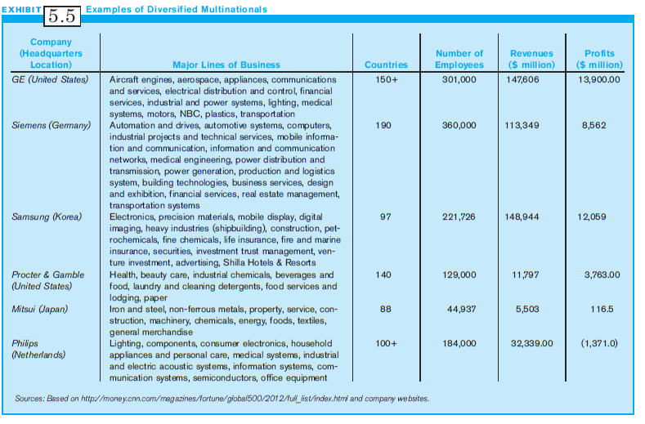
Exhibit 5.5:
Examples of Diversified MNCs

Slide 29
Strategy Formulation: Traditional Approaches
Strategy formulation is the process by which managers select the strategies to be used by their company.
Popular analysis techniques help understand the:
  The competitive dynamics of the industry
  Their company’s competitive position in the industry
  Opportunities and threats faced by their company
  Their company’s strengths and weaknesses

Slide 30
Industry and Competitive Analysis
Porter’s Five Forces Model: a popular technique that can help a multinational firm understand the major forces at work in the industry and the degree of attractiveness of the industry

Slide 31
Industry and
Competitive Analysis (1 of 2)
Porter’s Five Forces Model:
  The degree of competition among existing competitors in the industry
  The threat of new entrants
  The bargaining power of buyers
  The bargaining power of suppliers
  The threat of substitutes

Slide 32
Industry and
Competitive Analysis (2 of 2)
Managers must understand their industry well to formulate good strategies.
Managers must understand dominant economic characteristics of industries and driving forces.
Economic characteristics include:
  - Market size
  - Ease of entry and exit
  - Opportunities for economies of scale

Slide 33
Driving Forces
Driving Forces are the important changes that have potential to affect and change an industry in the future:
  - Speed of new product innovations
  - Technological changes
  - Changing societal attitudes and lifestyles

Slide 34
Key Success Factors (KSFs)
(1 of 2)
Key Success Factors (KSFs) are important characteristics of a company or its product that lead to success in an industry:
  - Innovative technology or products
  - Broad product line
  - Effective distribution channels
  - Price advantages
  - Effective promotion
  - Superior physical facilities or skilled labor

Slide 35
Key Success Factors (KSFs)
(2 of 2)
KSFs important characteristics (cont’d)
  - Experience of the firm in business
  - Cost position for raw materials
  - Cost position for production
  - R&D quality
  - Financial assets
  - Product quality
  - Quality of human resources

Slide 36
Competitor Analysis
Competitor Analysis is a 4-step profile of a competitor’s strategies and objectives:
  Identifying the basic strategic intent of competitors
  Identifying the generic strategies used and anticipated to be used by competitors
  Identifying the offensive and defensive competitive strategies used or to be used by competitors
  Assessing the current positions of competitors

Slide 37
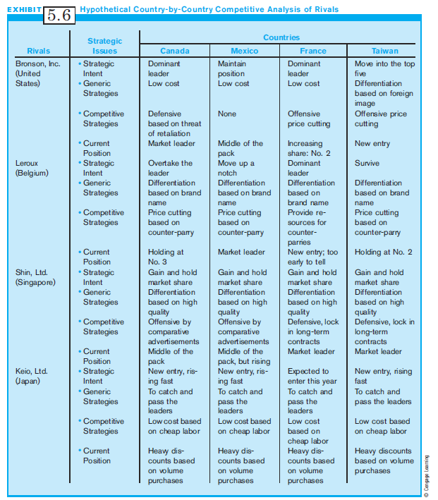
Exhibit 5.6:
Hypothetical Competitive Analysis of Rivals

Slide 38
Company-Situation Analysis: SWOT
Managers must understand what their company can and cannot do, so must assess:
  Strengths are distinctive capabilities, resources, skills or advantages relative to competitors; may come from technological superiority, marketing, etc.
  Weaknesses are the competitive disadvantages of a firm compared to its competitors.
  Opportunities are favorable conditions in the environment.
  Threats are unfavorable conditions in the environment.

Slide 39
SWOT Analysis
SWOT analysis is more complex for MNCs than for domestic firms.
Multinationals face more complex general and operating environments as they operate in more than one country.
Environments vary by country, so need to do a country by country SWOT.

Slide 40
Corporate Strategy Selection
A diversified corporation has a portfolio of businesses; the primary goal is to invest in profitable businesses.
The major strategic question is which businesses are targets for growth and investment, and which are targets for divestment or harvesting.
The basic tool: matrix analyses
The most popular is the growth-share matrix of the Boston Consulting Group (BCG).

Slide 41
BCG Share Matrix
BCG Share Matrix: Division into four categories based on market share and relative market share:
  Stars: the most successful firm
  Dogs: businesses with low market shares in low-growth industries
  Cash cows: businesses in slow-growth industries where company has strong market-share position
  Problem children: businesses in high-growth industries where company has a poor market share

Slide 42
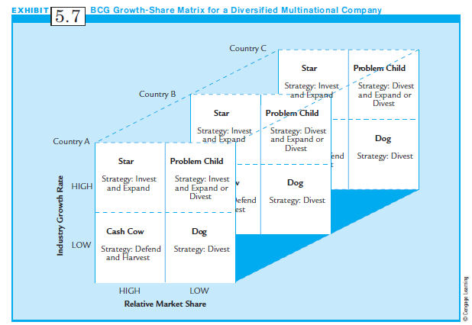
Exhibit 5.7:
The BCG Growth Share Matrix for a Diversified MNC

Slide 43
The National Context and Organizational Strategy:
Overview and Observations (1 of 2)
National context affects organizational design, strategy formulation, and content through the following processes:
  The social institutions and national and business cultures encourage or discourage certain forms of businesses and strategies in each nation; each has acceptable and unacceptable ways of doing business.
  Each nation must rely on its available factor conditions for developing its firms and industries. Local firms have easy access to local resources, and favor similar strategies to take advantage of their unique bundle of local resources.

Slide 44
The National Context and Organizational Strategy:
Overview and Observations (2 of 2)
  Social institutions and culture determine which resources are used, how they are used, and which resources are developed. The resource base limits the strategic options available to MNCs.
These points provide a general picture of the process by which national context affects strategic management.
Multinational managers can generalize and apply these ideas in order to understand the actions of rivals or alliance partners in any country where their firms do business.

Slide 45
Summary
The business environment becomes more global every day, and you will likely work in MNCs.
Multinational Managers must have a good understanding of multinational business strategy.
Several ways to formulate competitive strategies for the global market are listed.
The Multinational Manager must realize that strategy is a combination of planned intent and adaptive reactions.

